Slide 1
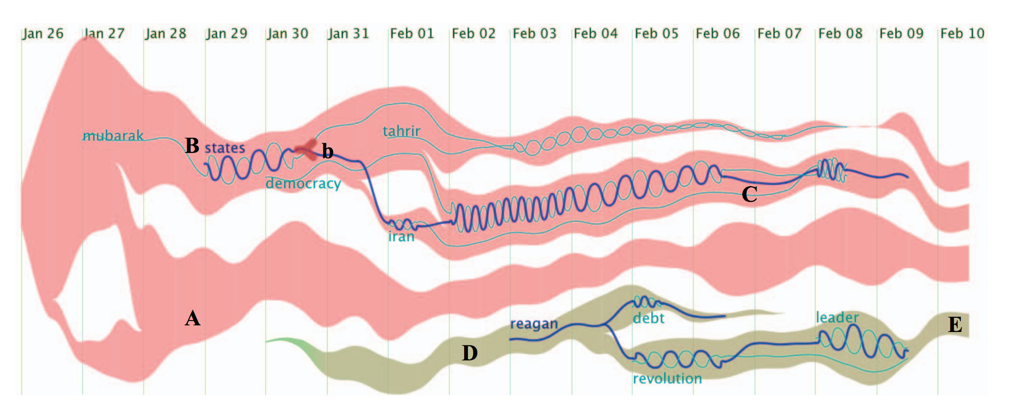

Case study 1: text flow

Slide 2
Case study 1: text flow
introduction
Data type:
text with time stamped
_ topic flow: text cluster
_ relationship between topics
Tasks:
the topic evolution trend
the critical event
the keyword correlation
Visual unit:
Stream graph
Glyph
thread
Notes:
Step1:introduction
Use edit data type,
Design task,
visual units,
the relationship between visual units
The relationship between visual units and design tasks

Slide 3
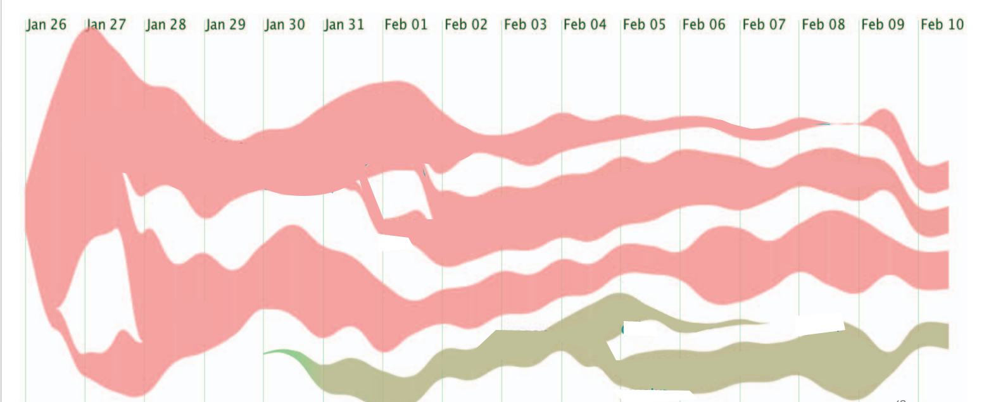
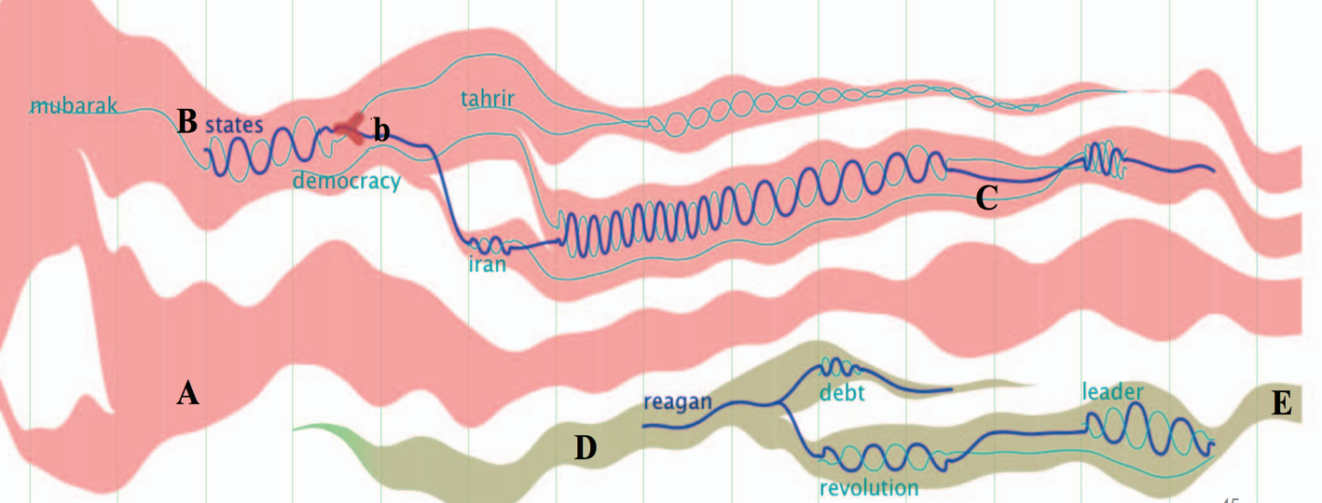
Stream graph
glyph
thread
Notes:
Step 2: visual units decomposition
A tree to show the relationship between visual units:
If A is the child of B, it means A logically depend on B
we should explain A first, then explain B. Like DFS.
At the beginning, there is no visual units showing on the figure;
When we visit a visual unit A (start to explain it), the corresponding tree node will has a border
When we finish the explanation of A, on figure: it will remain but its opacity will decrease,
on tree: the border will disappear
Then we will visit its child node, which has logic dependency on it.

Slide 4
Stream graph
glyph
thread
Notes:
Step 2: visual units decomposition
Flicker: an effective attention attractor.

Slide 5
Stream graph
glyph
thread
Notes:
Step 3: visual units explanation one by one following logic dependency
3.1: stream graph: build-in block available
3.2: glyph
3.3: thread

Slide 6
Stream graph
glyph
Stream graph:
Strip :
documents about a topic
thread
Documents about topic 1
Notes:
Step 3.1: visual unit1: stream graph (use build-in block: introduce the one without merging/splitting first)
3.1.1: coordinates: x-aixs;
y-aixs: stacked order, height
3.1.2: mark1--strip: encodes of the mark
channels: color hue
color saturation/opacity:
vertical position
width
start/end point

Slide 7
Stream graph
glyph
Stream graph:
Strip :
documents about a topic
x-position: time period of appearance
thread
Documents about topic 1
Early time Later time
Time line
Notes:
Step 3.1: visual unit1: stream graph (use build-in block: introduce the one without merging/splitting first)
3.1.1: coordinates: x-aixs;
y-aixs: stacked order, height
3.1.2: mark1--strip: encodes of the mark
channels: color hue
color saturation/opacity:
vertical position
width
start/end point

Slide 8
Stream graph
glyph
Stream graph:
Strip :
documents about a topic
x-position: time period of appearance
thread
No documents talking about topic 1 after time point B
Start to have documents talking about topic 1 at time point A
Documents about topic 1
Early time Later time
Time line
Notes:
Step 3.1: visual unit1: stream graph (use build-in block: introduce the one without merging/splitting first)
3.1.1: coordinates: x-aixs;
y-aixs: stacked order, height
3.1.2: mark1--strip: encodes of the mark
channels: color hue
color saturation/opacity:
vertical position
width
start/end point

Slide 9
glyph
Stream graph:
Strip
x-position: time period of appearance
Y- position: no meaning;
Stream graph
thread
Documents about topic 2b
Documents about topic 2a
Documents about topic 1a
Documents about topic 2c
Documents about topic 1b
Early time Later time
Time line
Notes:
Step 3.1: visual unit1: stream graph (use build-in block: introduce the one without merging/splitting first)
3.1.1: mark1--strip: encodes of the mark: documents about a topic
channels: vertical position ✓
stacked order ✓ no meaning
start/end point:
color hue(bonded with vertical position because they have the same encoding meaning)✓
color saturation/opacity:✓ no meaning
width
start/end point

Slide 10
glyph
Stream graph:
Strip
x-position: time period of appearance
Y- position: no meaning;
Color hue: different topics
Stream graph
thread
Documents about topic 2b
Documents about topic 2a
Documents about topic 1a
Documents about topic 2c
Documents about topic 1b
Early time Later time
Time line
Notes:
Step 3.1: visual unit1: stream graph (use build-in block: introduce the one without merging/splitting first)
3.1.1: mark1--strip: encodes of the mark: documents about a topic
channels: vertical position ✓
stacked order ✓ no meaning
start/end point:
color hue(bonded with vertical position because they have the same encoding meaning)✓
color saturation/opacity:✓ no meaning
width
start/end point

Slide 11
glyph
Stream graph:
Strip
x-position: time period of appearance
Y- position: no meaning;
Color hue: different topics
Color saturation/opacity: no meaning
Stream graph
thread
topic 2b
topic 2a
topic 1a
topic 2c
topic 1b
Early time Later time
Time line
Notes:
Step 3.1: visual unit1: stream graph (use build-in block: introduce the one without merging/splitting first)
3.1.1: mark1--strip: encodes of the mark: documents about a topic
channels: vertical position ✓
stacked order ✓ no meaning
start/end point:
color hue(bonded with vertical position because they have the same encoding meaning)✓
color saturation/opacity:✓ no meaning
width
start/end point

Slide 12
glyph
Stream graph:
Strip
x-position: time period of appearance
Y- position: no meaning;
Color hue: different topics
Color saturation/opacity: no meaning
Width: number of documents
Stream graph
thread
topic 2b
topic 2a
topic 1a
topic 2c
Less documents about topic 1 at this time point
topic 1b
Early time Later time
Time line
Notes:
Step 3.1: visual unit1: stream graph (use build-in block: introduce the one without merging/splitting first)
3.1.1: mark1--strip: encodes of the mark: documents about a topic
channels: vertical position ✓
stacked order ✓ no meaning
start/end point:
color hue(bonded with vertical position because they have the same encoding meaning)✓
color saturation/opacity:✓ no meaning
width
start/end point

Slide 13
glyph
Stream graph:
Strip
x-position: time period of appearance
Y- position: no meaning;
Color hue: different topics
Color saturation/opacity: no meaning
Width: number of documents
Stream graph
thread
topic 2b
topic 2a
topic 1a
topic 2c
Less documents about topic 1 at this time point
topic 1b
more documents about topic 1 at this time point
Early time Later time
Time line
Notes:
Step 3.1: visual unit1: stream graph (use build-in block: introduce the one without merging/splitting first)
3.1.1: mark1--strip: encodes of the mark: documents about a topic
channels: vertical position ✓
stacked order ✓ no meaning
start/end point:
color hue(bonded with vertical position because they have the same encoding meaning)✓
color saturation/opacity:✓ no meaning
width
start/end point

Slide 14
glyph
Stream graph:
Strip
x-position: time period of appearance
Y- position: no meaning;
Color hue: different topics
Color saturation/opacity: no meaning
Width: number of documents
Stream graph
thread
topic 2b
topic 2a
topic 1a
topic 2c
topic 1b
Early time Later time
Time line
Notes:
Step 3.1: visual unit1: stream graph (use build-in block: introduce the one without merging/splitting first)
3.1.1: mark1--strip: encodes of the mark: documents about a topic
channels: vertical position ✓
stacked order ✓ no meaning
start/end point:
color hue(bonded with vertical position because they have the same encoding meaning)✓
color saturation/opacity:✓ no meaning
width
start/end point

Slide 15
glyph
Stream graph:
Strip
x-position: time period of appearance
Y- position: no meaning;
Color hue: different topics
Color saturation/opacity: no meaning
Width: number of documents
Stream graph → merging/splitting
Stream graph
thread
topic 2b
topic 2a
topic 1a
topic 2c
topic 1b
merge
Early time Later time
Time line
Notes:
Step 3.1: visual unit1: stream graph (use build-in block: introduce the one without merging/splitting first)
3.1.1: mark1--strip: encodes of the mark: documents about a topic
channels: vertical position ✓
stacked order ✓ no meaning
start/end point:
color hue(bonded with vertical position because they have the same encoding meaning)✓
color saturation/opacity:✓ no meaning
width
start/end point

Slide 16
glyph
Stream graph:
Strip
x-position: time period of appearance
Y- position: no meaning;
Color hue: different topics
Color saturation/opacity: no meaning
Width: number of documents
Stream graph → merging/splitting
Stream graph
thread
topic 2b
splitting
topic 2a
topic 1a
topic 2c
splitting
topic 1b
merge
Early time Later time
Time line
Notes:
Step 3.1: visual unit1: stream graph (use build-in block: introduce the one without merging/splitting first)
3.1.1: mark1--strip: encodes of the mark: documents about a topic
channels: vertical position ✓
stacked order ✓ no meaning
start/end point:
color hue(bonded with vertical position because they have the same encoding meaning)✓
color saturation/opacity:✓ no meaning
width
start/end point

Slide 17
Stream graph
Glyph:
Node: encode: an event of a topic flow
position: x-time point, y-topic
color
size
shape
glyph
thread
topic 2b
topic 2a
topic 2c
Topic 1a
Documents about topic 1b
Early time Later time
Time line
Notes:
Step 3.1: visual unit1: stream graph (use build-in block: introduce the one without merging/splitting first)
3.1.1: mark1--strip: encodes of the mark: documents about a topic
channels（order of telling: complexity of encoding, visual salience, ）
vertical position： ✓
stacked order： ✓ no meaning
start/end point: ✓
color hue(bonded with vertical position because they have the same encoding meaning)✓
color saturation/opacity:✓ no meaning
width ✓

Slide 18
Stream graph
Glyph:
Node: encode: an event of a topic flow
position: x-time point, y-topic
color: no meaning
size
shape
glyph
thread
topic 2b
topic 2a
topic 2c
Topic 1a
Documents about topic 1b
Early time Later time
Time line
Notes:
Step 3.1: visual unit1: stream graph (use build-in block: introduce the one without merging/splitting first)
3.1.1: mark1--strip: encodes of the mark: documents about a topic
channels（order of telling: complexity of encoding, visual salience, ）
vertical position： ✓
stacked order： ✓ no meaning
start/end point: ✓
color hue(bonded with vertical position because they have the same encoding meaning)✓
color saturation/opacity:✓ no meaning
width ✓

Slide 19
Stream graph
Glyph:
Node: encode: an event of a topic flow
position: x-time point, y-topic
color: no meaning
size: importance score of this event
shape
glyph
thread
topic 2b
topic 2a
topic 2c
Topic 1a
Documents about topic 1b
Early time Later time
Time line
Notes:
Step 3.1: visual unit1: stream graph (use build-in block: introduce the one without merging/splitting first)
3.1.1: mark1--strip: encodes of the mark: documents about a topic
channels（order of telling: complexity of encoding, visual salience, ）
vertical position： ✓
stacked order： ✓ no meaning
start/end point: ✓
color hue(bonded with vertical position because they have the same encoding meaning)✓
color saturation/opacity:✓ no meaning
width ✓

Slide 20
Stream graph
Glyph:
Node: encode: an event of a topic flow
position: x-time point, y-topic
color: no meaning
size: importance score of this event
shape: source, sink, split, merge
glyph
thread
topic 2b
source
topic 2a
split
topic 2c
Topic 1a
Documents about topic 1b
merge
sink
Early time Later time
Time line
Notes:
Step 3.1: visual unit1: stream graph (use build-in block: introduce the one without merging/splitting first)
3.1.1: mark1--strip: encodes of the mark: documents about a topic
channels（order of telling: complexity of encoding, visual salience, ）
vertical position： ✓
stacked order： ✓ no meaning
start/end point: ✓
color hue(bonded with vertical position because they have the same encoding meaning)✓
color saturation/opacity:✓ no meaning
width ✓

Slide 21
Stream graph
Thread:
Line--encode: keyword
position: x-exist time period, y-topic it belongs
color: no meaning
thickness: thick one: primary keyword
thin one: non primary keywords
intensity:
glyph
thread
Keyword 1
topic 2b
topic 2a
topic 2c
Topic 1a
Documents about topic 1b
Early time Later time
Time line
Notes:
Step 3.1: visual unit1: stream graph (use build-in block: introduce the one without merging/splitting first)
3.1.1: mark1--strip: encodes of the mark: documents about a topic
channels（order of telling: complexity of encoding, visual salience, ）
vertical position： ✓
stacked order： ✓ no meaning
start/end point: ✓
color hue(bonded with vertical position because they have the same encoding meaning)✓
color saturation/opacity:✓ no meaning
width ✓

Slide 22
Stream graph
Thread:
Line--encode: keyword
position: x-exist time period, y-topic it belongs
color: no meaning
thickness: thick one: primary keyword
thin one: non primary keywords
intensity:
glyph
thread
topic 2b
Start time point
end time point
topic 2a
Keyword 1
topic 2c
Topic 1a
Documents about topic 1b
Early time Later time
Time line
Notes:
Step 3.1: visual unit1: stream graph (use build-in block: introduce the one without merging/splitting first)
3.1.1: mark1--strip: encodes of the mark: documents about a topic
channels（order of telling: complexity of encoding, visual salience, ）
vertical position： ✓
stacked order： ✓ no meaning
start/end point: ✓
color hue(bonded with vertical position because they have the same encoding meaning)✓
color saturation/opacity:✓ no meaning
width ✓

Slide 23
Stream graph
Thread:
Line--encode: keyword
position: x-exist time period, y-topic it belongs
color: no meaning
thickness: thick one: primary keyword
thin one: non primary keywords
intensity:
glyph
thread
topic 2b
topic 2a
Keyword 1
topic 2c
Topic 1a
Documents about topic 1b
Early time Later time
Time line
Notes:
Once the encoding of the mark, and the encoding of the position has been told.
All objects can be shown.

Slide 24
Stream graph
Thread:
Line--encode: keyword
position: x-exist time period, y-topic it belongs
color: category
thickness: thick one: primary keyword
thin one: non primary keywords
intensity:
glyph
thread
topic 2b
topic 2a
Keyword 1
topic 2c
Topic 1a
Documents about topic 1b
Early time Later time
Time line

Slide 25
Stream graph
Thread:
Line--encode: keyword
position: x-exist time period, y-topic it belongs
color: category
thickness: thick one: primary keyword
thin one: non primary keywords
intensity:
glyph
thread
topic 2b
topic 2a
Keyword 1
topic 2c
Topic 1a
Documents about topic 1b
Early time Later time
Time line

Slide 26
Stream graph
Thread:
Line--encode: keyword
position: x-exist time period, y-topic it belongs
color: category
thickness: thick one: primary keyword
thin one: non primary keywords
intensity: occurrence number of all involved keywords
glyph
thread
topic 2b
topic 2a
Keyword 1
topic 2c
Topic 1a
Documents about topic 1b
Early time Later time
Time line

